Slide 1


The Impact of Private Autonomous Vehicles on Vehicle Ownership and Unoccupied VMT Generation
Wenwen Zhang, Subhrajit Guhathakurta, Elias Khalil
January 8th, 2018
2018 TRB Conference | Washington D.C.

Slide 2


Deployment Models of AVs
Private AVs (PAVs)
Shared AVs (SAVs)
Transit Complementary AVs (TCAVs)

Slide 3
Existing Studies and Public Opinions
SAVs
Bansal et al. (2016)
13-35% expressed interests in SAVs
Krueger, Rashidi, & Rose (2016)
30% may try SAVs
Haboucha, Ishaq, & Shiftan (2017)
41% willing to participate SAV program
Burns, Jordan, & Scarborough, 2013
Spieser et al., 2014
Fagnant & Kockelman, 2014
Zhang et al., 2015
Greenblatt & Saxena, 2015
Chen, Kockelman, & Hanna, 2016
Zhang & Guhathakurta, 2017
Bansal et al., 2017
…
CTAVs
Chong et al., 2011
Shen et al., 2017
…
Schoettle & Sivak, 2015
PAVs

Slide 4
Research Questions
How Privately Owned AVs will change VEHICLE OWNERSHIP?
How much reduction can be achieved?
What type of family are more likely to benefit from AV technology and own less vehicles?
How much UNOCCUPIED VMT will be generated?
When PAVs relocate to serve different household members

Slide 5
Assumptions & Simplifications
No change in the travel behaviors;
The estimated VMT changes stems exclusively from the re-routing of unoccupied AVs from prior trip destination generated by another household member to the existing trip origin;
Vehicles are only shared by household members not among households;
It assumes a 100% market penetration rate and heterogeneity in the preferences for AVs are not considered.

Slide 6

Research Framework
STEP 1 Vehicle Reduction Potential
A greedy algorithm to determine minimum number of PAVs needed to serve each household
STEP 2 VMT Minimization
A MIP optimization model to optimize vehicle routes to minimize VMT
STEP 3 Spatial Patterns
A Trip Assignment Model to determine the spatial distribution of VMT
DATA
[1] Atlanta Travel Survey 2011
[2] Synthetic Trips from ARC Activity Based Model

Slide 7

STEP 1 Vehicle Reduction Potential A Greedy Algorithm
A Greedy Algorithm follows the problem solving heuristic of making the locally optimal choice at each stage with the hope of finding a global optimum.
Example Family owns 3 private conventional cars
1) Load all the vehicle trips
Origin
Destination
Departure time
Arrival time
1
6
7
8
12
17
18
19
Time of the day

Slide 8
STEP 1 Vehicle Reduction Potential A Greedy Algorithm
A Greedy Algorithm follows the problem solving heuristic of making the locally optimal choice at each stage with the hope of finding a global optimum.
Example Family owns 3 private conventional cars
Required Vehicle = 0
1) Load all the vehicle trips
2) Scan the trips by time of the day, add one more required vehicle if no existing vehicle can serve the trip
1
6
7
8
12
17
18
19
Time of the day

Slide 9
STEP 1 Vehicle Reduction Potential A Greedy Algorithm
A Greedy Algorithm follows the problem solving heuristic of making the locally optimal choice at each stage with the hope of finding a global optimum.
Example Family owns 3 private conventional cars
Required Vehicle = 0
1) Load all the vehicle trips
Required Vehicle = 1
2) Scan the trips by time of the day, add one more required vehicle if no existing vehicle can serve the trip
PAV Inventory
Busy = True Until Arrival Time
Location = Trip 1 Dest.
1
6
7
8
12
17
18
19
Time of the day

Slide 10
STEP 1 Vehicle Reduction Potential A Greedy Algorithm
A Greedy Algorithm follows the problem solving heuristic of making the locally optimal choice at each stage with the hope of finding a global optimum.
Example Family owns 3 private conventional cars
Required Vehicle = 1
1) Load all the vehicle trips
2) Scan the trips by time of the day, add one more required vehicle if no existing vehicle can serve the trip
PAV Inventory
PAV Inventory
Busy = False
Location = Trip 1 Dest.
Busy = True Until Arrival Time
Location = Trip 1 Dest.
1
6
7
8
12
17
18
19
Time of the day

Slide 11

STEP 1 Vehicle Reduction Potential A Greedy Algorithm
A Greedy Algorithm follows the problem solving heuristic of making the locally optimal choice at each stage with the hope of finding a global optimum.
Example Family owns 3 private conventional cars
Required Vehicle = 1
ENOUGH TIME* to relocate from trip 1 destination to current trip origin before current trip departures ??
NO: Add one PAV
YES: Don’t add
* Time from Google API, reflects congestion
1) Load all the vehicle trips
2) Scan the trips by time of the day, add one more required vehicle if no existing vehicle can serve the trip
PAV Inventory
PAV Inventory
Busy = False
Location = Trip 1 Dest.
Busy = True Until Arrival Time
Location = Trip 1 Dest.
1
6
7
8
12
17
18
19
Time of the day

Slide 12
STEP 1 Vehicle Reduction Potential A Greedy Algorithm
A Greedy Algorithm follows the problem solving heuristic of making the locally optimal choice at each stage with the hope of finding a global optimum.
Example Family owns 3 private conventional cars
Required Vehicle = 1
1) Load all the vehicle trips
2) Scan the trips by time of the day, add one more required vehicle if no existing vehicle can serve the trip
PAV Inventory
PAV Inventory
Busy = True Until Arrival Time
Location = Trip 2 Dest.
Busy = True Until Arrival Time
Location = Trip 1 Dest.
1
6
7
8
12
17
18
19
Time of the day

Slide 13
STEP 1 Vehicle Reduction Potential A Greedy Algorithm
A Greedy Algorithm follows the problem solving heuristic of making the locally optimal choice at each stage with the hope of finding a global optimum.
Example Family owns 3 private conventional cars
Required Vehicle = 1
1) Load all the vehicle trips
2) Scan the trips by time of the day, add one more required vehicle if no existing vehicle can serve the trip
PAV Inventory
PAV Inventory
Busy = True Until Arrival Time
Location = Trip 2 Dest.
Busy = True Until Arrival Time
Location = Trip 1 Dest.
1
6
7
8
12
17
18
19
Time of the day

Slide 14
STEP 1 Vehicle Reduction Potential A Greedy Algorithm
A Greedy Algorithm follows the problem solving heuristic of making the locally optimal choice at each stage with the hope of finding a global optimum.
Example Family owns 3 private conventional cars
Required Vehicle = 2
1) Load all the vehicle trips
2) Scan the trips by time of the day, add one more required vehicle if no existing vehicle can serve the trip
PAV Inventory
PAV Inventory
Busy = …
Location …
Busy = True Until Arrival Time
Location = Trip 1 Dest.
Busy = …
Location …
1
6
7
8
12
17
18
19
Time of the day

Slide 15
STEP 1 Vehicle Reduction Potential A Greedy Algorithm
A Greedy Algorithm follows the problem solving heuristic of making the locally optimal choice at each stage with the hope of finding a global optimum.
Example Family owns 3 private conventional cars
Required Vehicle = 2
1) Load all the vehicle trips
2) Scan the trips by time of the day, add one more required vehicle if no existing vehicle can serve the trip
PAV Inventory
PAV Inventory
Busy = …
Location …
Busy = True Until Arrival Time
Location = Trip 1 Dest.
Busy = …
Location …
3) Check Minimum Number of PAVs needed
1
6
7
8
12
17
18
19
Time of the day

Slide 16
STEP 1 Vehicle Reduction Potential Applied to Atlanta Travel Survey
18.3% of the households may reduce vehicle ownership even if they maintain the current travel schedule.
9.5% vehicle ownership reduction
Logistic Regression Model

Slide 17
STEP 1 Vehicle Reduction Potential Applied to Atlanta Travel Survey

Slide 18
STEP 2 VMT Minimization MIP VMT Minimization Model
The vehicle route output from Greedy Algorithm may not provide optimum vehicle route solution for the family!
Example Family
PAV 1
PAV 2
1
6
7
8
12
17
18
19
Time of the day

Slide 19
STEP 2 VMT Minimization MIP VMT Minimization Model
There are hundreds or even thousands of vehicle routes that PAVs can serve this family. How to find the optimal one efficiently?
Example Family
PAV 1
PAV 2
1
6
7
8
12
17
18
19
Time of the day

Slide 20
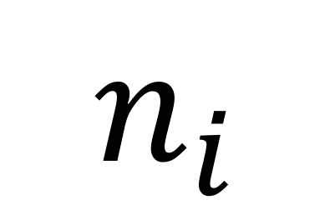
STEP 2 VMT Minimization MIP VMT Minimization Model
Develop a Trip Connectivity Graph
Example Family, 2 required PAVs
$$n_{i}$$
Nodes are vehicle trips
1
6
7
8
12
17
18
19
Time of the day

Slide 21
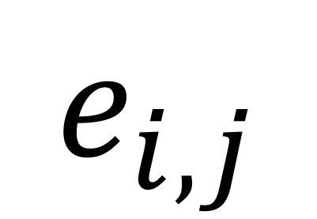
STEP 2 VMT Minimization MIP VMT Minimization Model
$$e_{i,j}$$
Develop a Trip Connectivity Graph
Example Family, 2 required PAVs
20
18
1) Nodes are vehicle trips
X
2) Edges: Connect Trips ONLY IF there is enough relocation time
3) Edge Cost = Relocation VMT
4) Edge is directed based on time
0
5
1
6
7
8
12
17
18
19
Time of the day

Slide 22
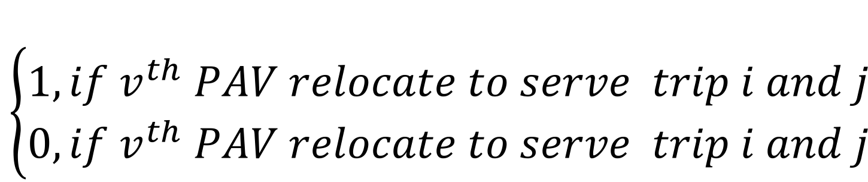
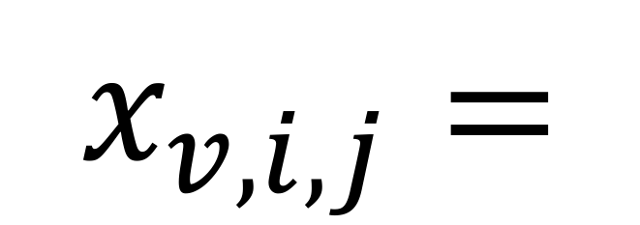
STEP 2 VMT Minimization MIP VMT Minimization Model
Decision variable:
$$x_{v,i,j}=$$
$\left\{\begin{aligned}1, if v^{th} PAV relocate to serve trip i and j \\ 0, if v^{th} PAV relocate to serve trip i and j\end{aligned}\right.$

Slide 23
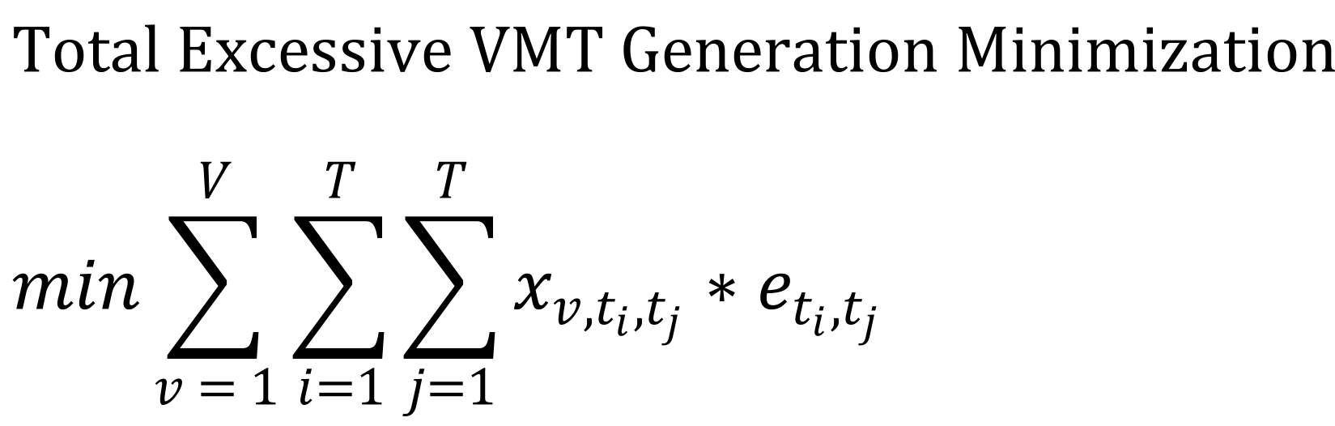
STEP 2 VMT Minimization MIP VMT Minimization Model
Objective Function
$$Total Excessive VMT Generation Minimization$$
$$min\sum_{v = 1}^{V}{\sum_{i=1}^{T}{\sum_{j=1}^{T}{x_{v,t_{i},t_{j}}∗e_{t_{i}, t_{j}}}}}$$

Slide 24
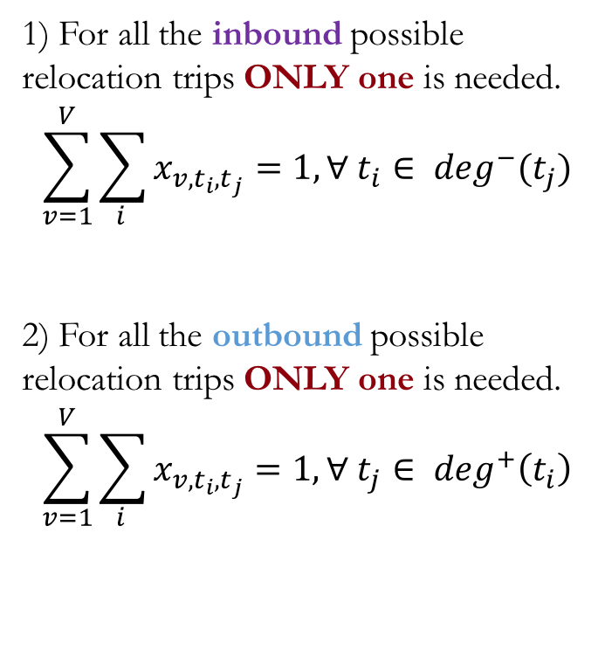
STEP 2 VMT Minimization MIP VMT Minimization Model
Model Constrains
1) For all the inbound possible relocation trips ONLY one is needed.
$$\sum_{v=1}^{V}{\sum_{i }{x_{v,t_{i},t_{j}}}}=1, ∀ t_{i}∈ \deg^{−}(t_{j})$$
2) For all the outbound possible relocation trips ONLY one is needed.
$$\sum_{v=1}^{V}{\sum_{i }{x_{v,t_{i},t_{j}}}}=1, ∀ t_{j}∈ \deg^{+}\left(t_{i}\right)$$
Example Family, 2 required PAVs
1
6
7
8
12
17
18
19
Time of the day

Slide 25
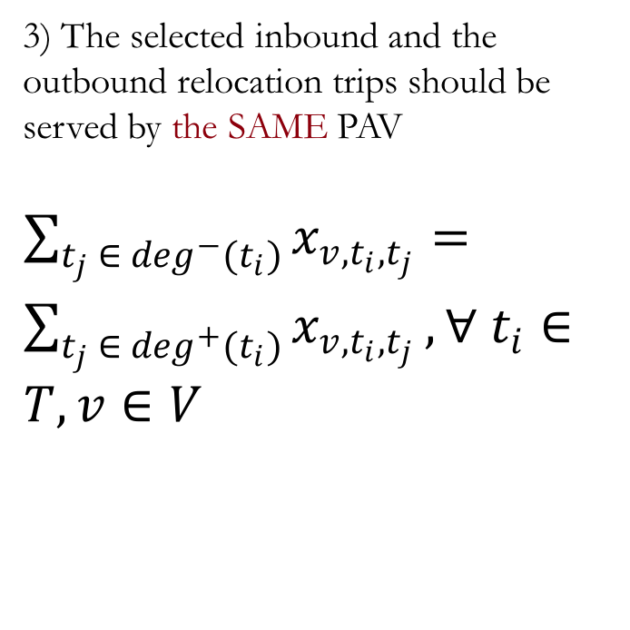
STEP 2 VMT Minimization MIP VMT Minimization Model
Model Constrains
3) The selected inbound and the outbound relocation trips should be served by the SAME PAV
$\sum_{t_{j} ∈ \deg^{−}(t_{i})}{x_{v,t_{i},t_{j}}}=\sum_{t_{j} ∈ \deg^{+}(t_{i})}{x_{v,t_{i},t_{j}}}, ∀ t_{i}∈T, v∈V$
Example Family, 2 required PAVs
1
6
7
8
12
17
18
19
Time of the day

Slide 26
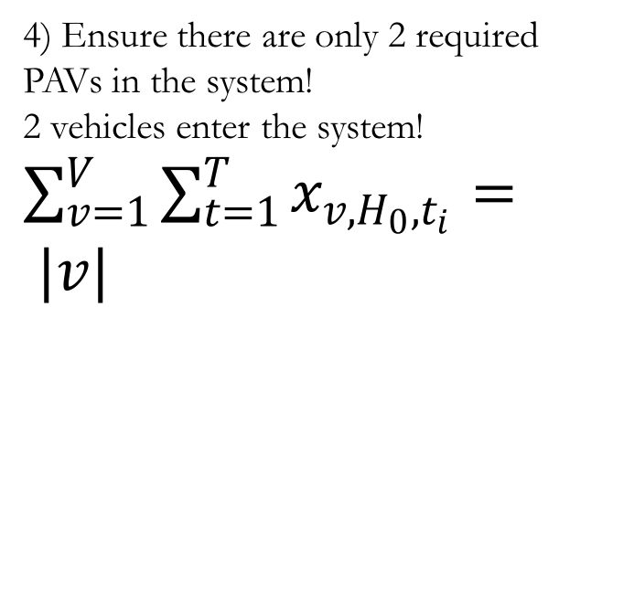
STEP 2 VMT Minimization MIP VMT Minimization Model
Model Constrains
Example Family, 2 required PAVs
4) Ensure there are only 2 required PAVs in the system!
2 vehicles enter the system!
$\sum_{v=1}^{V}{\sum_{t=1}^{T}{x_{v,H_{0},t_{i}}}}= |v|$
1
6
7
8
12
17
18
19
Time of the day

Slide 27
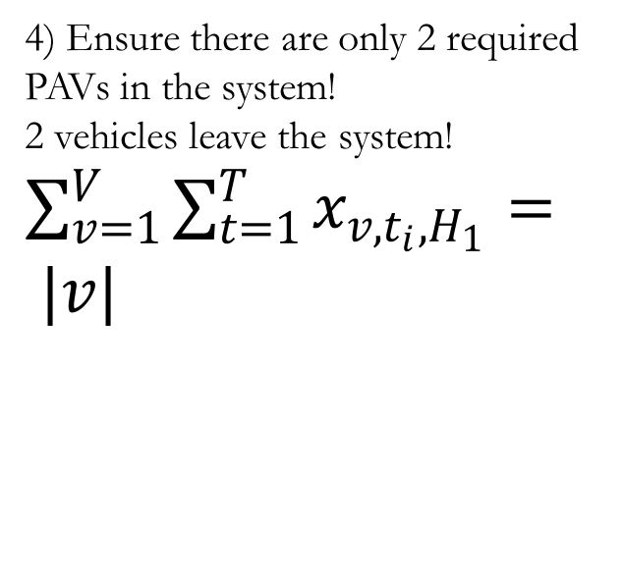
STEP 2 VMT Minimization MIP VMT Minimization Model
Model Constrains
Example Family, 2 required PAVs
4) Ensure there are only 2 required PAVs in the system!
2 vehicles leave the system!
$\sum_{v=1}^{V}{\sum_{t=1}^{T}{x_{v,t_{i},H_{1}}}}= |v|$
1
6
7
8
12
17
18
19
Time of the day

Slide 28
STEP 2 VMT Minimization MIP VMT Minimization Model
Model Constrains
Example Family, 2 required PAVs
4) Ensure there are only 2 required PAVs in the system!
2 vehicles leave the system!
$\sum_{v=1}^{V}{\sum_{t=1}^{T}{x_{v,t_{i},H_{1}}}}= |v|$
1
6
7
8
12
17
18
19
Time of the day

Slide 29
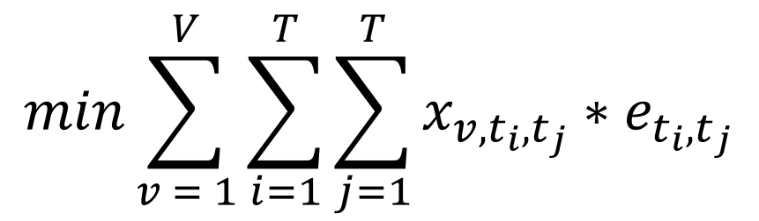
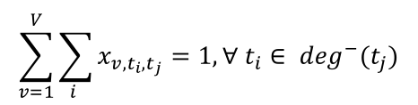
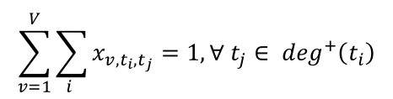
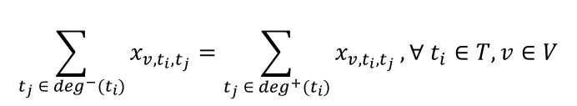
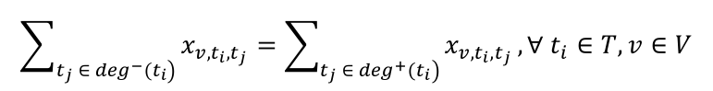
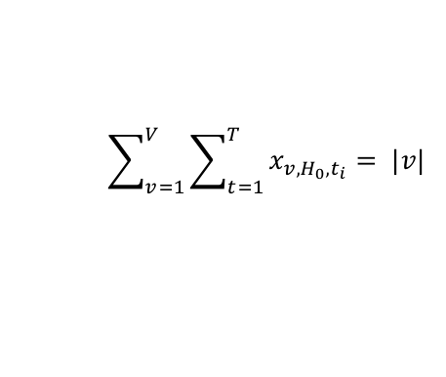
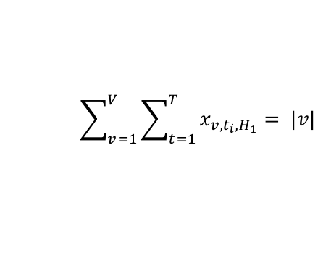
STEP 2 VMT Minimization MIP VMT Minimization Model
Objective Function
Subject to
$$min\sum_{v = 1}^{V}{\sum_{i=1}^{T}{\sum_{j=1}^{T}{x_{v,t_{i},t_{j}}∗e_{t_{i}, t_{j}}}}}$$
$$\sum_{v=1}^{V}{\sum_{i }{x_{v,t_{i},t_{j}}}}=1, ∀ t_{i}∈ \deg^{−}(t_{j})$$
[1]
[2]
$$\sum_{v=1}^{V}{\sum_{i }{x_{v,t_{i},t_{j}}}}=1, ∀ t_{j}∈ \deg^{+}\left(t_{i}\right)$$
[3]
$$\sum_{\left.t_{j} ∈ \deg^{−}(t_{i}\right)}{x_{v,t_{i},t_{j}}}=\sum_{\left.t_{j} ∈ \deg^{+}(t_{i}\right)}{x_{v,t_{i},t_{j}}}, ∀ t_{i}∈T, v∈V$$
$$\sum_{t_{j} ∈ \deg^{−}(t_{i})}{x_{v,t_{i},t_{j}}}=\sum_{t_{j} ∈ \deg^{+}(t_{i})}{x_{v,t_{i},t_{j}}}, ∀ t_{i}∈T, v∈V$$
[4]
[5]
$$\sum_{v=1}^{V}{\sum_{t=1}^{T}{x_{v,H_{0},t_{i}}}}= |v|$$
[6]
$$\sum_{v=1}^{V}{\sum_{t=1}^{T}{x_{v,t_{i},H_{1}}}}= |v|$$

Slide 30
STEP 2 VMT Minimization Applied to ARC Travel Survey
Households, on average, will produce 29.8 more VMT per day per reduced vehicle.
The total VMT generation in the metropolitan area will rise by 13.3%

Slide 31
STEP 2 VMT Minimization Applied to ARC Travel Survey

Slide 32
STEP 3 Spatial Distribution Trip Assignment Model
Applied the previous 2 steps to ARC synthesized trips
Travel survey doesn’t have all OD pairs
Generate relocation trip OD matrix
Combine relocation trip OD matrix with Existing trip OD matrix
Run Trip Assignment in CUBE

Slide 33
STEP 3 Spatial Distribution V/C Ratio Changes by Road Type and Time of the Day
Increase by
2.4-3.0%
4.3-5.0%
2.8-4.0%
3.7-4.9%
7.5-9.2%

Slide 34
STEP 3 Spatial Distribution V/C Ratio Changes by Area Types
4.3-6.5%
7-9.4%
6.8-8.4%
8-9.9%
8.9-10.7%
8.2-10.4%
8-9.8%

Slide 35
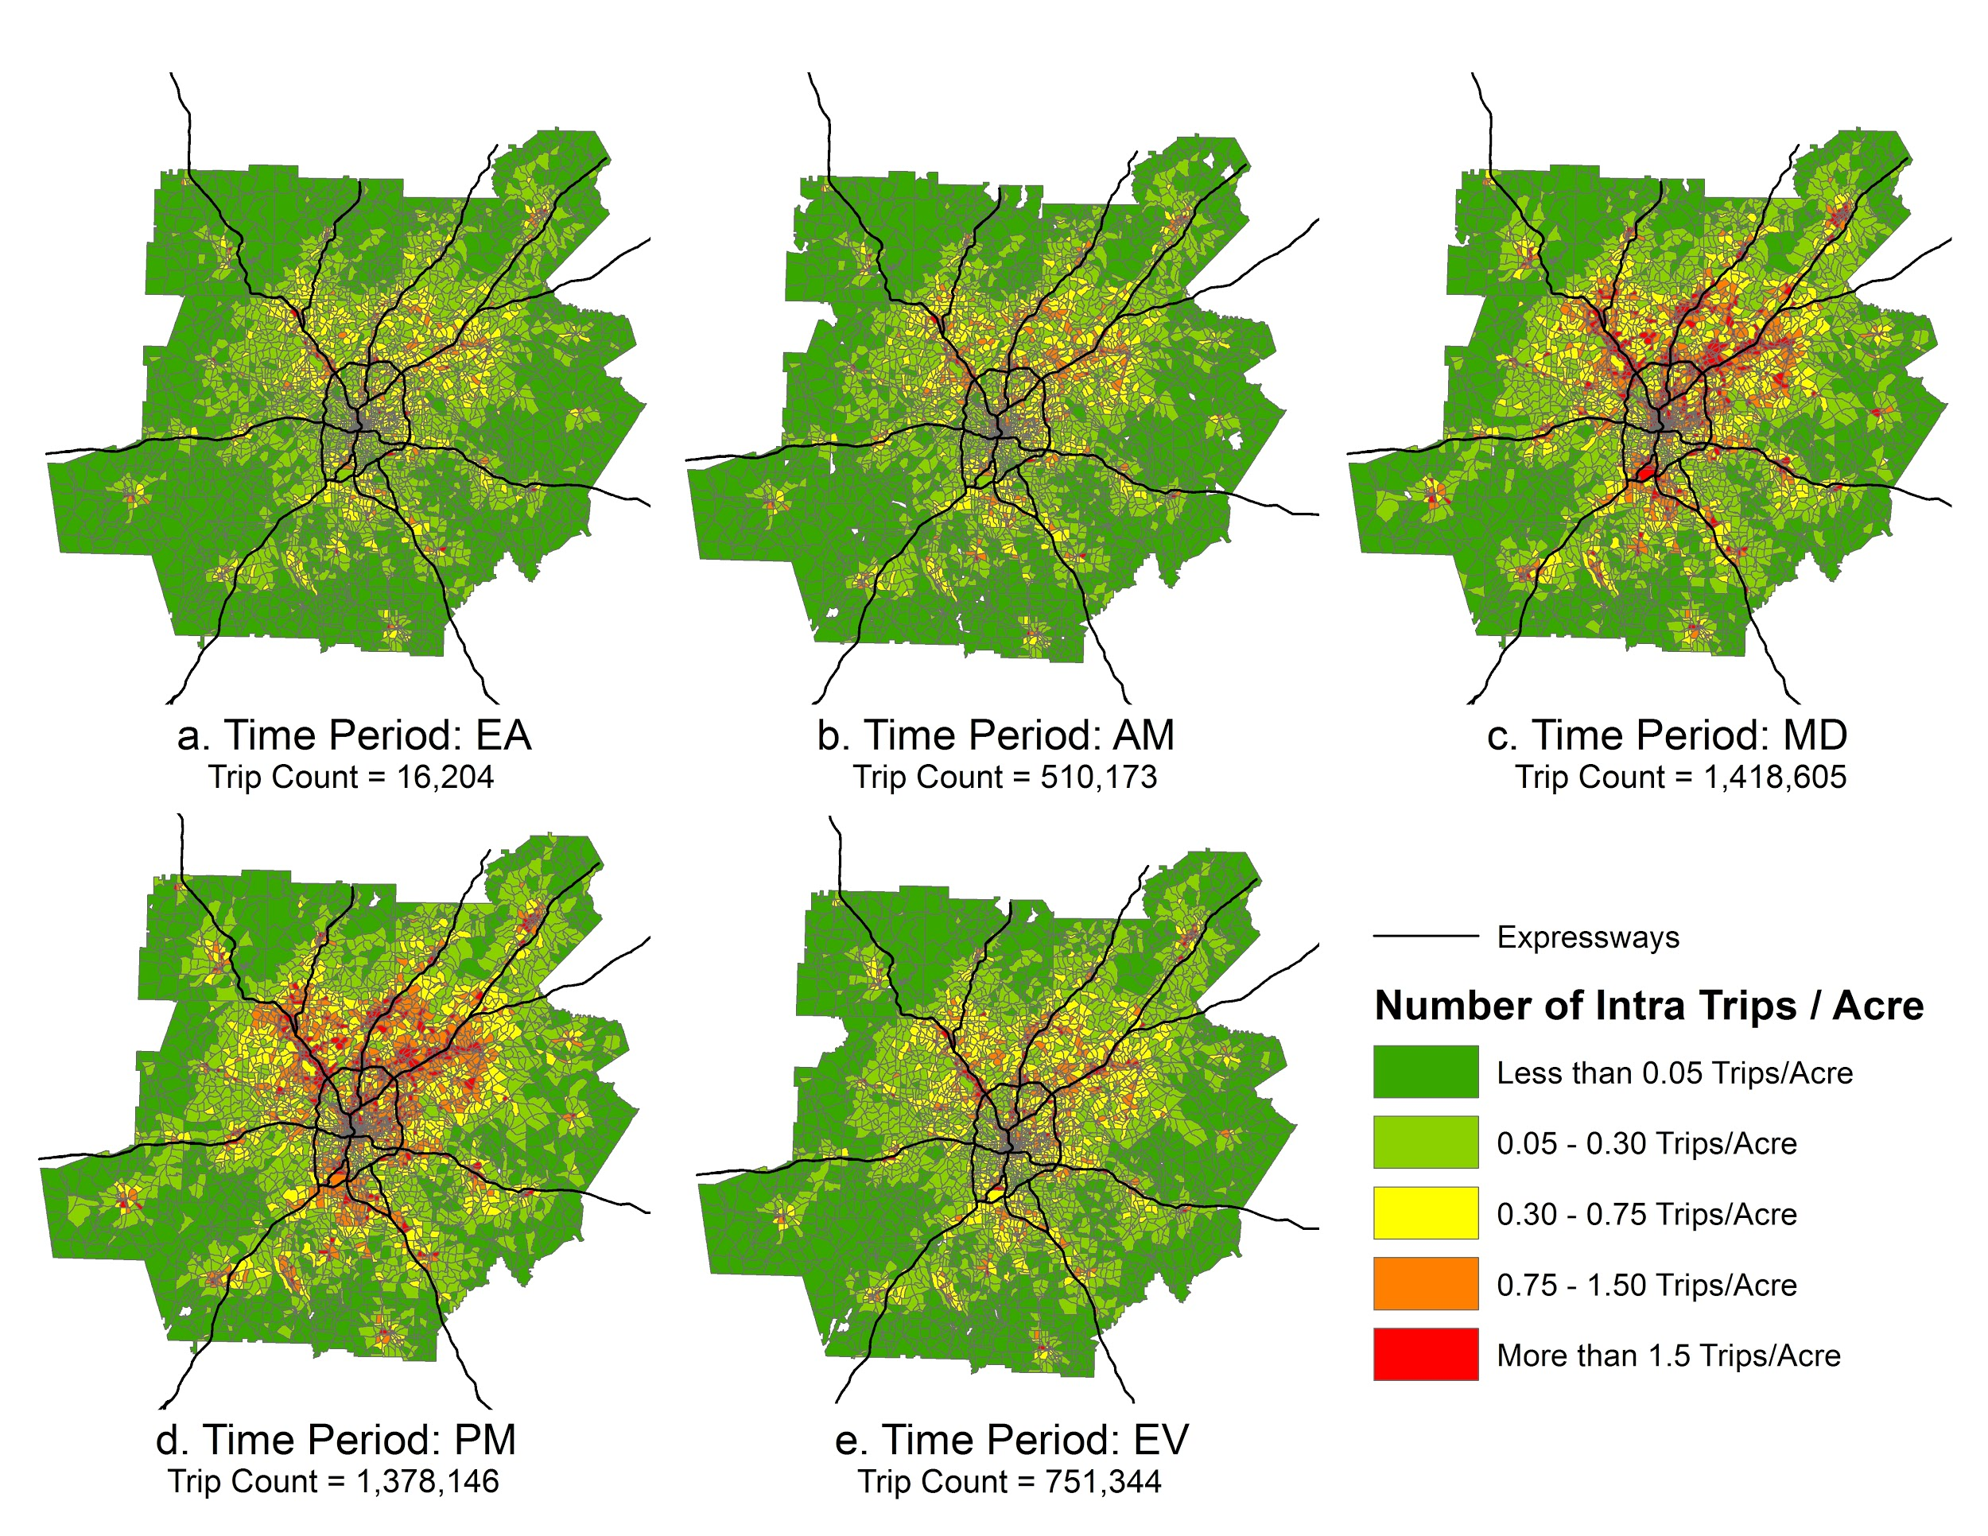
STEP 3 Spatial Distribution Intra-zonal relocation trips
Mostly observed during midday and evening peak hours
Midday: Concentrate in commercial TAZs
Evening Peak: Sprawl into mixed and residential TAZs

Slide 36
Discussions and Conclusions
18.3% of the households may reduce vehicle ownership even if they follow current travel patterns; 9.5% vehicle ownership reduction
Households, on average, will produce 29.8 more VMT per day per reduced vehicle; The VMT generation in the metropolitan area will rise by 13.3%
Impact on transportation infrastructure is NOT evenly distributed
Suburban and rural areas
Minor and local roads

Slide 37
Thank You
Questions & Comments

